Slide 1
DDoS Detection and Mitigation using Machine Learning
By
Arpit Gawande
Written under the guidance of
Dr. Jean-Camille Birget

Slide 2
DDoS Attack and Challenges deal with it
What is DDoS attack
Disable host by jamming network or its resources.
Types
  Volume-based
  Application-based
  Low-rate
Challenges in dealing with DDoS attacks
  Many participating systems at different regions
  IP spoofing (Source address not reliabe)
  Interdependency (Different modules)
  Incompatibility (Different companies have different implementations)
  Expensive (Centralized hardware)

Slide 3
DDoS Detection and Mitigation
Detection:
- Identify anomalous behavior in the traffic
- At server, at ISP or at router.
Mitigation
- Blocking anomalous packets reaching their destination.
Use router-based analysis, avoid expensive hardware, use system compatible with all the networking devices.

Slide 4
Network Functioning
Router does packet forwarding
Any packet traveling on Internet has to go through router
Routers combine has all the necessary knowledge about the packet flow (number of packets going to a destination) and the path (to the destination)
Router uses ICMP protocol to share operational information

Slide 5
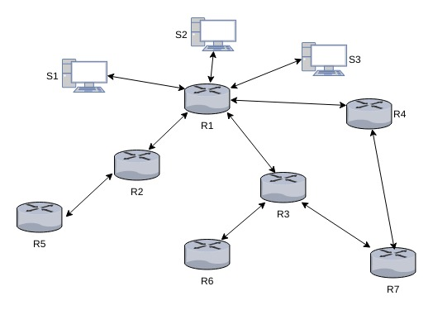
Network Structure

Slide 6
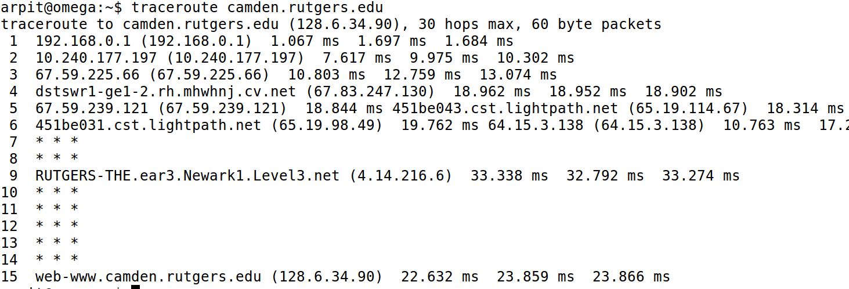
Trace Route Example

Slide 7
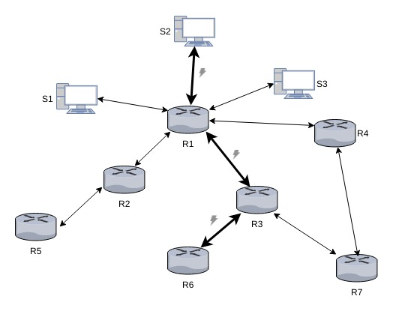
Thesis Approach
The router as a point of analysis
- Understand flow behavior using learning techniques which don't use lots of resources.
- Know the source of attack or the path of the packet travel (GeoIP services are not useful)

Slide 8
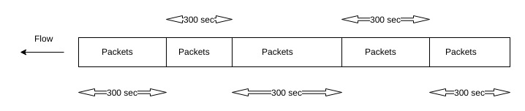
Flow capturing at the router
A flow consists of several Internet packets captured during a fixed time interval.
Flow information is used for analysis

Slide 9
Analysis Techniques
Each router will have analysis module.
Create feature vectors.
Create Clusters of similar destination traffic
Novelty Detection algorithm for enhancing the results.

Slide 10
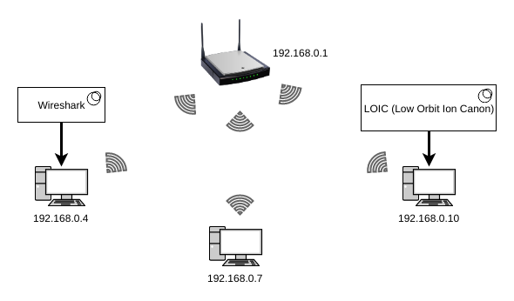
Implementation
Volumed-based DDoS attack analysis
Use of bots to launch attacks
Tools Used:
  Low Orbit Ion Canon(LOIC)
  Wireshark

Slide 11
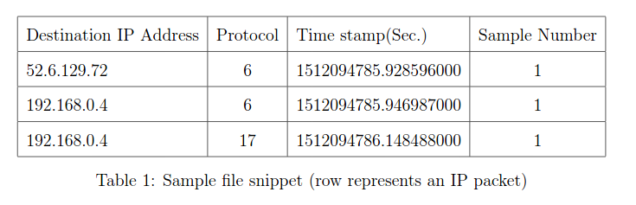
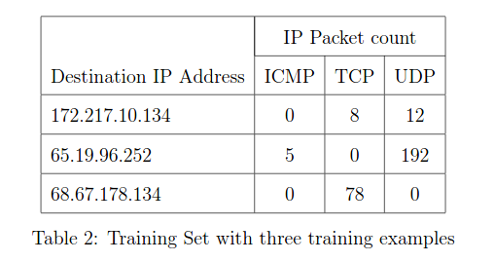
Captured Flow and Training Set

Slide 12
Machine Learning
According to Tom Mitchell (1998), a computer program is said to learn from an experience E with respect to some task T and some performance measure P, if its performance on T, as measured by P, improves with experience.
Supervised Learning
Unsupervised Learning

Slide 13
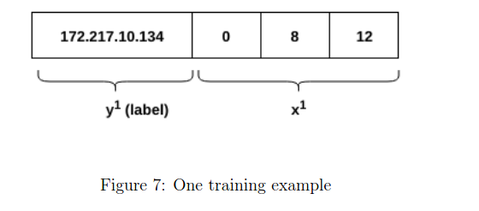
Training Example

Slide 14

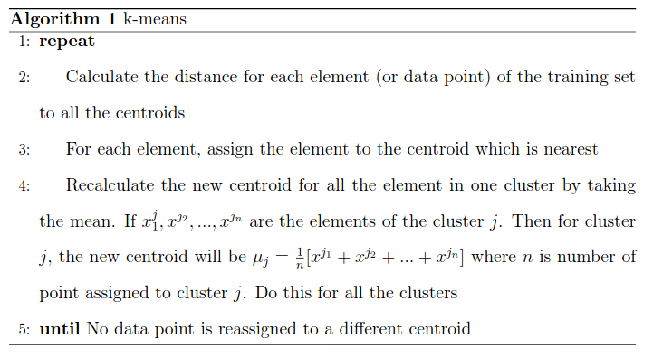
Clustering
Feature Scaling
K-means Lloyd's algorithm

Slide 15
Clustering Continued..
Multiple training sets.
Clustering using k-means++ algorithm.
Determine number of clusters using elbow method.
Determine the central vectors called centroids for each training set.
Get mean centroid by finding median and removing outliers
Use the newly calculated centroid to cluster training sets.

Slide 16
Anomaly Detection using One Class Support Vector Machine
How to handle situation where IP is assigned to same cluster?
Create boundary around the clusters.
Label training sets in a cluster with cluster number.
Use One Class Support Vector Machine (SVM).

Slide 17
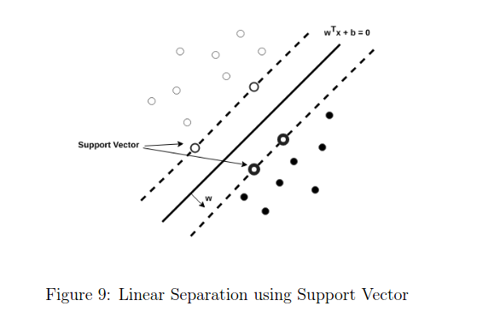
Support Vector Machine (SVM)

Slide 18
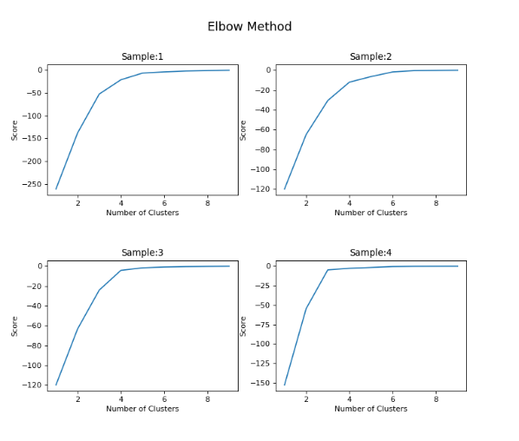
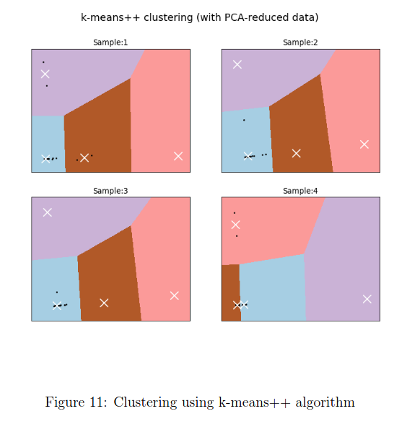
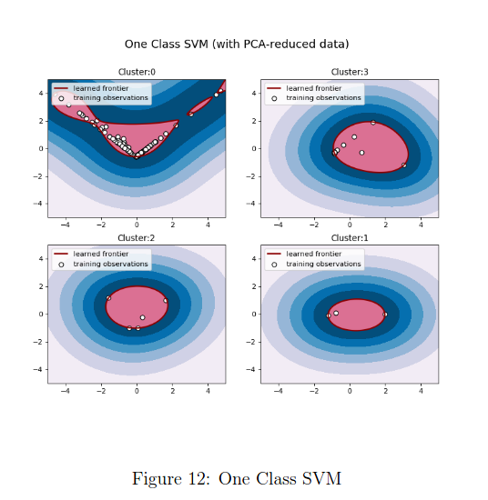
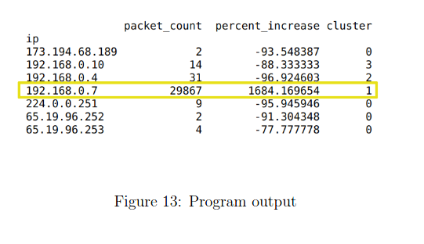
Detection Simulation

Slide 19
Mitigation
Install detection program on every router.
- Network Function Virtualization (NFV) can help to add functionality to the networking devices remotely.
Block all the packets belong to destination under attack (Given by Detection program).
For more informed decision, communicate detection information with server or other routing devices.

Slide 20
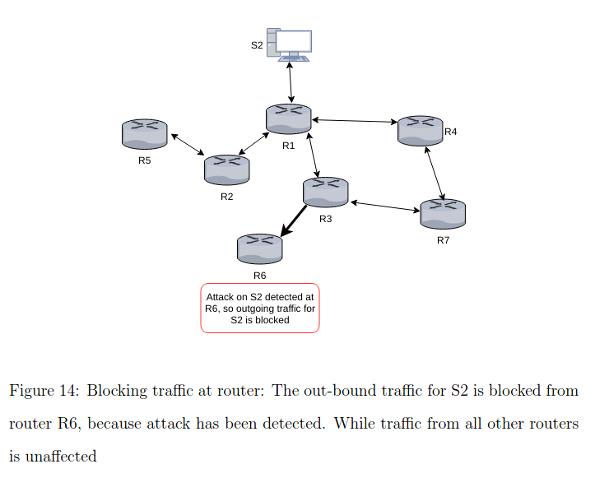
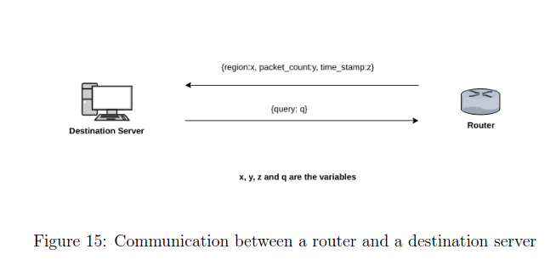
Mitigation Continued...

Slide 21
Conclusion
DDoS attacks are real threat to everyone on the Internet.
Difficult detection due to spoofing.
Use of router for detection and mitigation of DDoS attacks.

Slide 22
Thank You!

